Slide 1

Sellinger Applied Portfolio Report
December 2013
Notes:
*

Slide 2

Table of Contents
I. Economic Conditions & News Highlights
II. Sector Summaries
III. SAP Strategy & Composition
IV. Risk Analysis
V. SAP Performance Evaluation
VI. Recommended Future Enhancements
VII. Student Manager Profiles

Slide 3
Economic Conditions & News Highlights
Notes:
Completed Powerpoints (by date)
9/17
9/19
10/1
10/10
10/24
11/7
11/14
*

Slide 4
Unemployment
Sept. 2012 | Aug. 2013 | Sept. 2013 | Oct. 2013
8.1% | 7.3% | 7.2% | 7.3%
bls.gov/news_releases/archives
inflationdata.com

Slide 5
Inflation
Sept. 2012 | Aug. 2013 | Sept. 2013 | Oct. 2013
1.7% | 1.5% | 1.2% | 1.0%
bls.gov/news_releases/archives
inflationdata.com

Slide 6

Housing Market
Housing prices
  Home prices still surging - but pace of gains has steadied as interest rates continue to rise
  Rates rising to almost 4.6%
  Overall 12.1% increase over the past year
    Smallest price increase: NY, 3.3%
    Largest price increase: Las Vegas, 24.9%
bloomberg.com/news (August 28, 2013)

Slide 7
Commodities
Oil rises due to Fed policy decision
  Price of oil rose over $106/barrel as traders prepared for expected decrease in Fed’s monetary stimulus
  Rose to $110/barrel earlier this month (September) in relation to the current events covered in Syria
  Also, U.S. expected to surpass Russia & Saudi Arabia as world’s top oil producer by 2015
Other energy futures
  Wholesale gasoline rose 0.99 cents to $2.66/gal
  Natural gas fell 0.60 cents at $3.84 per 1,000 cubic ft
    Up roughly 2.4% for the year
  Heating oil declined 0.42 cents to $2.99/gal
Gold & silver after Fed’s “no tapering” surprise
  Gold & silver rose while dollar plunged to nearly its lowest level of the year (after Fed announcement)
  Gold prices increased 4.19% to $1,366/oz - marketing the biggest gain in almost 5 yrs
  Gold: down about 25.31% this past year
  Silver increased 6.17% to $23.18/oz
Yahoo Finance (September 19, 2013)
money.cnn.com/data/commodities (October 1, 2013)
CNN Money (November 14, 2013)

Slide 8

The Federal Reserve
Announcement (September 2013)
  Fed decides not to curtail stimulus effort
    Continue to buy $85 mil a month in bonds
    Fiscal policy “restraining economic growth”
    Markets jumped
    Utilities
  Next Fed chair
    Larry Summers withdrew his name for Fed Chairmanship
    Janet Yellen poised to accept bid
Bloomberg; NY Times (September 2013)

Slide 9

Government Shutdown
Shutdown on the way (October 1, 2013)
  The inability of Congress to pass a funding bill - resulting in a partial government shutdown for the first time in 17 years
  Immediate results:
    787,000 government employees unable to work
    If lasts 1 month, GDP could fall 1.4% for the quarter
    Could signal to the market that U.S. government can’t be trusted to make payments on time

Slide 10
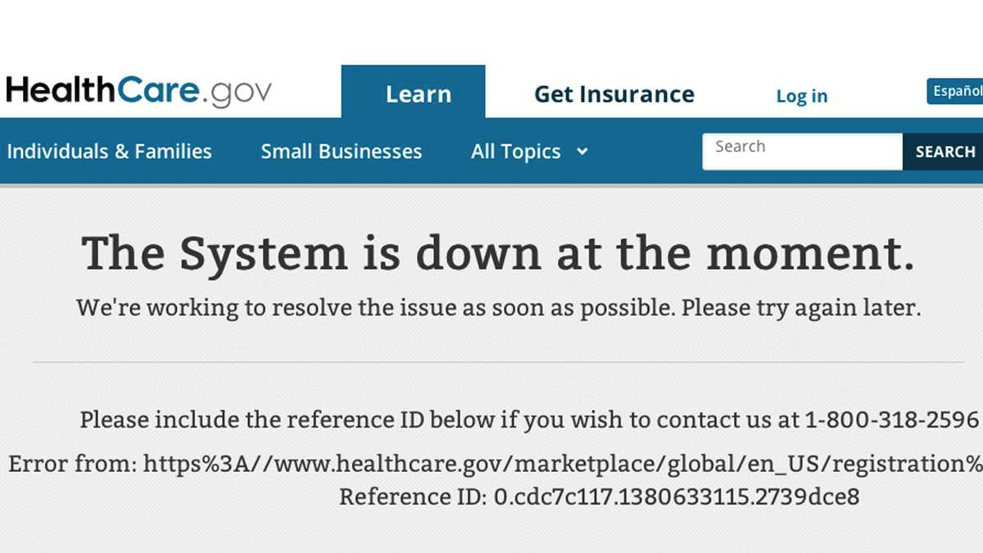
Obamacare Website
Major website issues
  Experts say it can’t be solved before year’s end
  Best fix would probably be to completely start over
  If roughly 20% of Healthcare.gov needs to be rewritten, then it’s estimated to take 6 months-1 yr to complete
    Includes 500 million lines of code
  Technology problems & design flaws partially blamed for poor enrollment
  Just over 100,000 people enrolled in Oct. - falling short of Obama admin’s 500,000 goal
businessweek.com
money.cnn.com

Slide 11

Twitter IPO
IPO follow-up (November 14, 2013)
  Opened at $45.10 - up 73% from the $26 IPO price
  Shares closed at $44.90 on opening day
  IPO created 1,600 millionaires
    Mostly rank-and-file employees
Bloomberg; WSJ; CNN

Slide 12

Johnson & Johnson Settlement
Settlement details
  $2.2 bn settlement
  NJ penalized for fines & forfeiture to the federal government & several other states
  Deliberately hid potential risks
  One of the country’s largest healthcare settlements
  Same type of deceptive marketing back in April 2011
  Paid $1.2 bil in fines to Arkansas
    “Today’s imposition of more than $1.2 billion in penalties sends a clear signal that big drug companies like JNJ cannot lie to the FDA, patients, and doctors”
- Dustin McDaniel, Arkansas Attorney General
money.cnn.com

Slide 13

China
Home prices spike 15% in key Chinese cities (September 18, 2013)
  Housing prices in China have increased 15% in the past year
    Most notably in Shanghai & Beijing
  On average, new home prices have increased 7.5% over the previous year
  Analysts are worried of a possible housing bubble
2012 GDP growth revised down to 7.7% (October 24, 2013)
  Slowest year of growth for China since 1999
  Rebound this summer based on “unofficial economic stimulus”
bloomberg.com
money.cnn.com

Slide 14

Greece
Debt in Greece (October 10, 2013)
  US firm says to buy up Greek bonds - under the belief that Greek debt is “massively undervalued”
  Government in Greece is on track to deliver a primary budget surplus
    Despite the debt crisis in Europe that occurred last fall

Slide 15

Japan
Asset tapering (October 24, 2013)
  Japan will carry out similar asset purchase tapering as US - but, still years away
    Watch how US markets are affected in tapering, as it will be similar
    Japan is tapering off $70 bil/month in purchases
Olympics (October 24, 2013)
  Tokyo announced as site for 2020 Olympic games
  Consider how this will affect the Japanese economy
  Asian stocks rally after this announcement

Slide 16
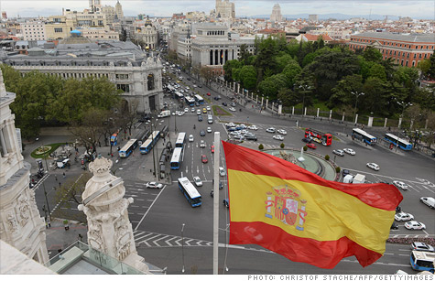
Spain
End of recessions in Spain fuels hope for Eurozone (October 24, 2013)
  Spain’s central bank declared that the 2-yr recession ended in Q3 with reported 0.1% growth
  Turnaround in Spain adds the expectation that the Eurozone’s economy will continue to grow over the next quarter & increase consumer confidence
  Rise in GDP was driven by an increase in the export sector & a decrease in imports
  However, the confidence measure remains at -13.3
    Reflects how the unemployment rate has yet to fall from record times

Slide 17
Sector Summaries
Notes:
*

Slide 18
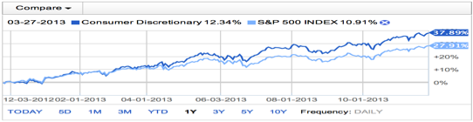
Consumer Discretionary
SUMMARY: Foot Locker (FL), Hasbro (HAS), HLF (Herbalife), Starbucks (SBUX), Wyndham (WYN)
-XLY outperformed S&P 500 since year start 1/1/13, returning 37.89% versus S&P 500 27.91% return
-14.18% portfolio contribution compared to 12.40% S&P 500 contribution
OUTLOOK: Largely affected by the current market and economic conditions as consumers view this sector as luxury
-Recommend overweight position with upcoming holiday season & recent reports that the Fed will
be keeping rates low

Slide 19
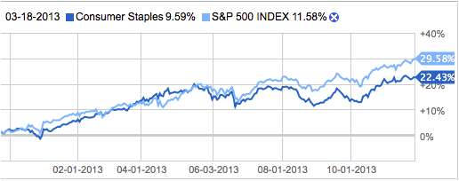
Consumer Staples
SUMMARY: Comprises companies whose businesses are less sensitive to economic cycles
-Includes manufacturers and distributors of food, beverages and tobacco and producers of non-durable household goods and personal products. It also includes food & drug retailing companies as well as hypermarkets and consumer supercenters
-Some well-known companies in this sector are Procter & Gamble, Coca-Cola, PepsiCo, Kellogg, Kimberly-Clark, and Phillip Morris International
OUTLOOK: Although challenged by macroeconomic events and lowered consumer spending, our outlook for the consumer staple environment is positive. We expect improvements in 2014 with an expected +9.3% growth and +4.1% in revenue, driven by expected recovery in the economy and job environment.
Zack’s Investment Research

Slide 20
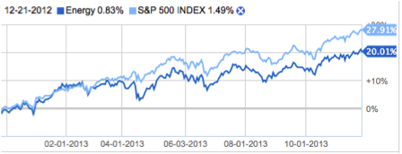
Energy
SUMMARY: The Energy Sector comprises companies whose businesses are dominated by the following activities: The construction or provision of oil rigs, drilling equipment. Companies engaged in the exploration, production, marketing, refining and/or transportation of oil and gas products, coal and other consumable fuels.
OUTLOOK: Energy remains positive given the commodity’s constrained supply picture. Global oil consumption is expected to get a boost from sustained strength in China, the Middle East, Central and South America that continue to expand at a healthy rate.
-According to the Energy Information Administration (EIA), which provides official energy statistics from the U.S. Government, world crude consumption grew by an estimated 0.7 million barrels per day in 2012 to a record-high level of 89.0 million barrels per day.
Zack’s Investment Research

Slide 21
Financials
SUMMARY: Financials sector performed well - returned about 31.11% for the year
-Low interest rates spurred consumer borrowing, M&A activity was high for the year driving up the performance of the financials sector
–IPO markets were extremely active for the year because equity was so cheap
-Financials contributed about 11.7% for the SAP fund
OUTLOOK: Remain underweight in financials due to the difficulty of banks to generate profits
-Especially with rising interest rates and the tapering of QE3
-Best performingà XLF ETF with 15.9% return in SAP fund

Slide 22
Healthcare
SUMMARY: Healthcare had a total return of 38.53%
–SAP Fund return 22.68%
–Best performing sector
–Best performer: Johnson and Johnson 36% return
–Worst Performer: Celgene Corporation -1.50% return
OUTLOOK: Recommend being overweight in healthcare sector going forward
–Changing economics of sector with the passage of Affordable Care Act present opportunities in healthcare IT

Slide 23
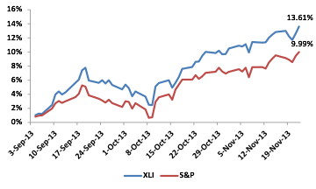
Industrials
SUMMARY: B/E Aerospace, Culp Inc., United Technologies, SPDR Industrials ETF (XLI)
–XLI slightly outperformed S&P 500 since 09/03, returning 13.6% versus S&P 500 10% return
–10.4% portfolio contribution compared to 10.7% S&P 500 contribution
OUTLOOK: Highly cyclical and highly correlated to S&P 500 amounting to an underweight allocation in the sector
–Sector performance is largely driven by macroeconomic trends and is an outperformer during expansionary periods and underperformer during periods of contraction

Slide 24
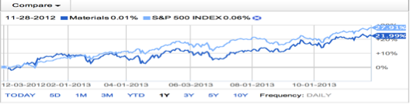
Materials
SUMMARY: Sherwin Williams Company (SHW), SPDR Materials ETF (XLB)
–XLB underperformed S&P 500 since year start 1/1/13, returning 21.99% versus S&P 500 27.91% return
–Sherwin Williams showing returns of 1.58% since purchase on 10/3/13
–4.82% portfolio contribution compared to 3.50% S&P 500 contribution
OUTLOOK: Basic materials markets are deeply cyclical. In boom times, producers mint money but in downturns, many players can go bankrupt
–Given past four months of consistent growth and potential for investment in foreign markets in 2014, Materials may provide impressive returns despite underperformance in past year

Slide 25
Technology
SUMMARY: XLK select sector SPDR had an 18.45% YTD total return
–5.73% return for SAP fund
–Best performing in SAP fund: Apple with 25% return
–Worst performing: Cisco Systems with 1% return
–Tessco Technologies with -1.75% return
OUTLOOK: Slightly overweight the Information Technology sector going forward
–Performance of new tech companies like Twitter, Google, and Facebook will not be largely affected by tapering
–Tech demand and growth forecasted to be greater in 2014 than in 2013

Slide 26
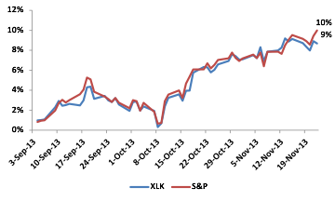
Telecommunications
SUMMARY: NeuStar Inc. is the single pure play telecom holdings in the portfolio
–SPDR Technology ETF (XLK) offers exposure to telecom conglomerates comprising 12 percent of the ETF’s NAV
–Verizon and AT&T, 4.5% and 5.8% weights within the ETF respectively
OUTLOOK: Historically poor performing sector, underweight contribution in the SAP portfolio, below the S&P contribution, as a result
–Slightly underperformed the S&P 500 since 09/03, 10% versus 9%
–High D/E and high valuation multiples make investment in the sector difficult per SAP strategy requirements

Slide 27
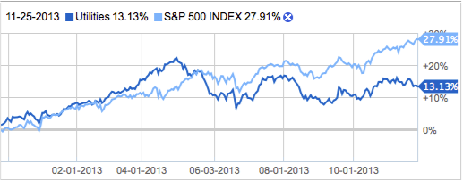
Utilities
SUMMARY: The Utilities Sector encompasses those companies considered electric, gas or water utilities, or companies that operate as independent producers and/or distributors of power.
–Utilities reflected growth of 0.7% year over year in the second quarter of 2013 compared to 3.1% registered by the S&P 500 companies.
OUTLOOK: Utilities are expected to improve upon their previous quarter's performance. They are expected to register a 2.4% year-over-year increase, outpacing the S&P 500 beat of 0.5% over the same period.

Slide 28
SAP Strategy & Composition
Notes:
*

Slide 29
Growth Strategy
Stop Loss Criteria
Establish at 80% of Purchase Price
Evaluate as information and stock price changes.
If stock appreciates – move stop loss up accordingly (consider trailing / crawling stop)
If company business fundamentals deteriorate – raise stop loss or sell per sell criteria.
Earnings miss, lower guidance, slowing revenue growth etc.
Sell Criteria
Re-evaluate positions when:
  The price reaches 10% below target price
  The price is 20% above purchase price.
Evaluate Sell under following:
  Company loses its leadership position
  Company business fundamentals deteriorate.
  Slowing unit volume, revenue decline, etc.
  Superior investment alternatives are identified.
Buy Criteria
Conservative Mentality – Expect to perform better than industry
Revenue growth ≈> industry average and forecasted to continue
Strong Earnings ~ 5 years of CAGR
ROE ≈ ≥ 15% and > Industry Average
PEG ≈ ≤ 1.2 and < Industry Average
Debt / Equity < 1.5 (or Acceptable Interest Coverage Ratio when D/E >1.0)

Slide 30
Value Strategy
Stop Loss Criteria
0.20% below purchase price if all buy criteria are met
Adjust lower for additional risk (i.e., some buy criteria are not met)
Increase stop loss to take profit as price increases
Consider the use of crawling / trailing stops as stock begins to rise.
Sell Criteria
Re-evaluate positions when:
  Merger or acquisition news
  Significant earnings restatement
  Change in executive management
  Exceed initial price target
  Price approaches sell stop
  Superior investment alternatives are identified
Evaluate Sell under following:
  Beginning to trend downwards
  Significant industry news
Buy Criteria
Goal: To find stocks priced less than their intrinsic value.
Price/Sales < industry average
Price/Book Value < industry average
Dividends > Industry Average
Positive Free Cash Flow

Slide 31
Dividend Strategy
Stop Loss Criteria
20% below purchase price is all buy criteria are met
Consider crawling / trailing stops to protect profits.
Sell Criteria
Superior investment alternatives are identified
Dividends are cut
Free cash flow diminishes
Stock price loses (≈20%)
Buy Criteria
Dividend Yield ≥ SPDR S&P Dividend ETF
Quick Ratio ≥ Industry Average
Total cash dividends paid annually
Total cash from investing activities
Total cash from operating activities
Is there a constant dividend?
Is there historical and potential dividend growth?

Slide 32
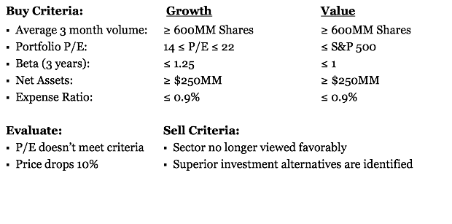
ETF Growth & Value Strategies

Slide 33
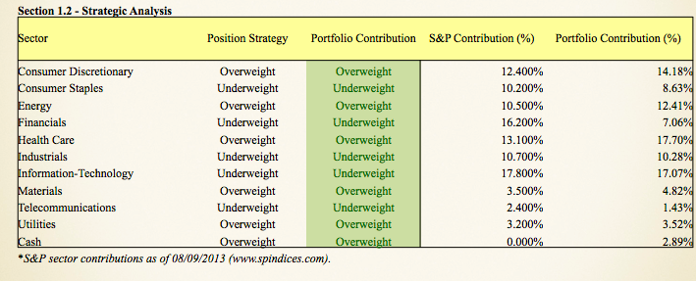
Strategic Analysis Contributions

Slide 34
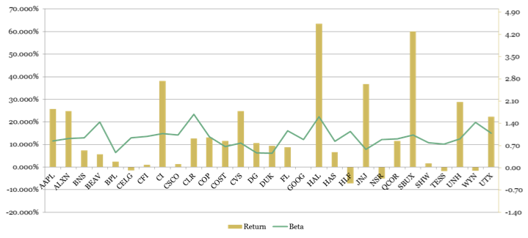
Overall Return & Beta

Slide 35
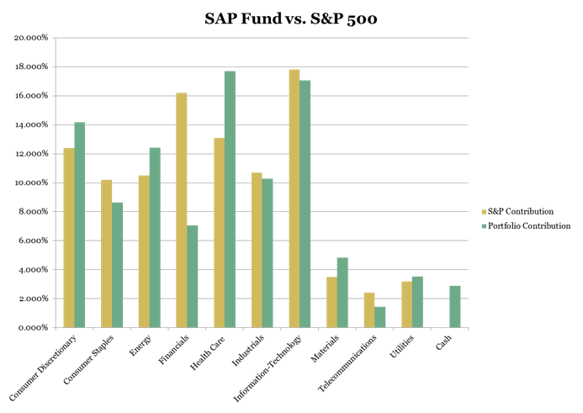

Slide 36
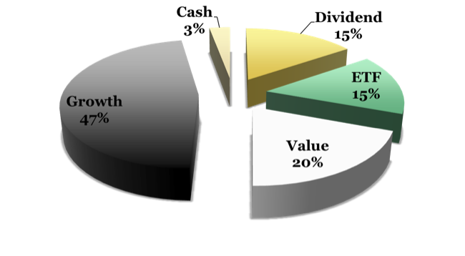
SAP Holdings by Strategy

Slide 37

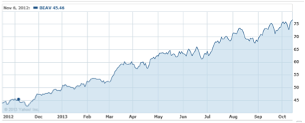
B/E Aerospace (BEAV)
Sector: Industrials
Industry: Aerospace/defense products & services
Bought at: $77.35
Return: 5.69%
Leading manufacturer of aircraft passenger cabin interior products
Partnerships with United Airlines, Delta, etc.
1-yr performance:
Growth requirement | Industry | BEAV
5-yr CAGR | 6.9% | 13%
YTD Growth | 24.18% | 74.1%
D/E < 1.5 | 0.8 | 0.8
PEG < 1.2 | --- | 1.1

Slide 38

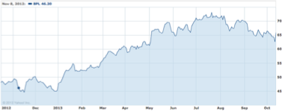
Buckeye Partners, L.P. (BPL)
Sector: Energy
Industry: Oil & gas pipelines
Bought at: $65.87
Return: 2.38%
Operates refined petroleum products in US
Owns & operates approx. 6,000 miles of pipeline
Beta: 0.65
Market cap: $7.05 bil
1-yr performance:
Value requirement | Industry | BPL
Price/sales | 3.27 | 1.6
Price/BV | 2.8 | 2.6
Div. yield | 4.5% | 6.4%
Positive FCF | Varies | Yes- $385 mil

Slide 39

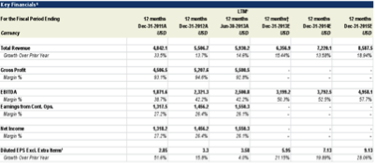
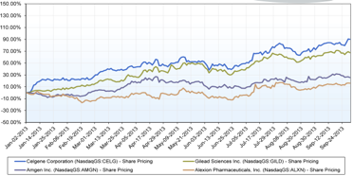
Celgene Corporation (CELG)
Celgene is a biopharmaceutical company engaged in discovery and commercialization of innovative therapies designed to treat cancer & immune-inflammatory related diseases
Investment rationale:
- Strong financials
- Strong growth: 5 Yr forecast 20.9%
- Strong analyst recommendations:
- 86.7% Buy consensus
- Healthcare Industry present strong outlook:
- Change in economics of industry
- Passage of ACA --> Obamacare
- NYP (NYSE Healthcare Index Fund)
- Outperformed S&P500 YTD by 5.72% in total return
- IYH (iShares US Healthcare ETF)
- 29.23% total return vs. SPX 18.69%
- YTD Return for Healthcare industry approx. 27% second best performing industry after consumer discretionary
- Fulfills SAP Growth Strategy requirements
- Bought 80 shares at $151.20

Slide 40

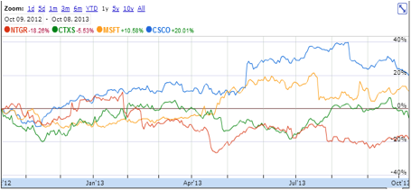
Cisco (CSCO)
Sector: Technology
Industry: Networking & communication devices
Bought at: $23.20
Return: 1.3%
Worldwide leader in Internet networking
1-yr performance vs. competitors:
Value requirement | Industry | CSCO
Price/sales | 1.9 | 2.5
Price/BV | 2.5 | 2.1
Div. yield | 2.16% | 2.74%

Slide 41

Continental Resources Inc. (CLR)
Sector: Materials
Industry: Independent oil & gas
Bought at: $101.19
Exploration & production of onshore oil-prone plays in US
Strong growth potential tied to natural gas boom
CLR gas production projected to increase 32% in 2014
Deregulation favors natural gas compared to other commodities

Slide 42

Culp Inc. (CFI)
Sector: Industrials
Industry: Textiles
Bought at: $18.97
Manufactures & markets upholstery fabrics & mattress tickings
Has maintained constant growth
Growth requirement | Industry | CFI
5-yr CAGR | 17.09% | 39.63%
Rev. Growth (3-yr avg) | 3.2% | 9.2%
ROE | 5.4% | 18.9%
PEG | 0.69 | 0.55
D/E | 0.6 | 0.1

Slide 43

Foot Locker Inc. (FL)
Sector: Consumer Discretionary
Industry: Apparel - footwear & accessories
Bought at: $33.09
Athletic retailer that operates stores in N. America, Europe, Australia
Provides footwear & apparel through Foot Locker, Lady Foot Locker, Kids Foot Locker, Champs Sports
Company focused on efficient growth
24 new stores in Q2
Cash, equivalents, ST investments: $836 mil
Consistent quarterly div. yield of 2.3% since 2003
Value requirement | Industry | FL
Price/sales | 1.8 | 0.79
Price/BV | 4.2 | 2.05
Div. yield | 1.5% | 2.3%
Positive FCF | Varies | Yes- $253 mil

Slide 44

Google (GOOG)
Sector: Technology
Industry: Internet information providers
Bought at: $1,015.89
A premier investment

Slide 45

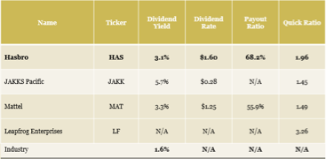
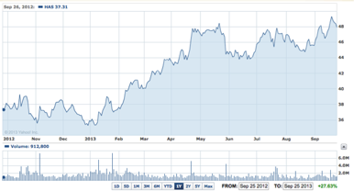
Hasbro (HAS)
Hasbro produces family and children products and services all over the world. It has products under brands such as Transformers, Nerf, My Little Pony, Playskool, and G.I. Joe
Investment rationale:
- 2013 Annaul EPS est. is 2.88 and in 2014 is expected to be 3.21
- Forward annual dividend yield of 1.6 or 3.30%
- Strong current valuation in comparison to its competitors, particularly in its dividend yield and payout ratio
- Meets criteria for SAP Dividend Strategy
- Payout ratio of 60%
- Strong Revenue upside:
- Revenue increased from $644M in first quarter to $766M in the second quarter
Bought 313 shares at $47.35

Slide 46

Herbalife Ltd. (HLF)
Sector: Consumer discretionary
Industry: Personal products
Bought at: $67.29
A global network marketing company that sells products in 79 countries worldwide
Sells products for weight management, targeted nutrition, energy, sports, fitness, etc.
Significantly undervalued
Fair value calculation = $91.50
Dividend strategy:
Div. yield = 1.84 (compared to 1.31 for industry)
Quick ratio = 1.48 (compared to 0.67 for industry)

Slide 47

Lear Corporation (LEA)
Sector: Consumer discretionary
Industry: Auto parts
*Was recommended, but not purchased ($70.94 → $81.19)
Leading provider of electrical & seating systems
Strong analyst ratings
Strong Q3 earnings
Revenue & EPS greater than expected
Growth requirement | Industry | LEA
5-yr CAGR | 7% | ---
ROE | 21.3% | 46.53%
PEG | --- | 0.85
D/E | 0.6 | 0.4

Slide 48

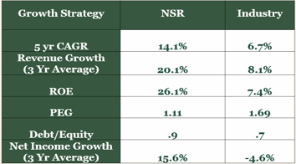
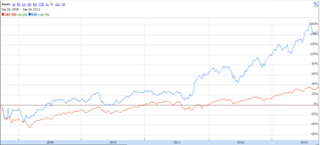
NeuStar (NSR)
NeuStar supplies real-time analytics and information for telecommunication, the Internet, entertainment, and marketing industries, and is also a provider of clearinghouse and directory services to the global communications and Intern industries
Investment rationael:
- Strong financials when compared with other Telecoms
- History of outperforming the S&P and competitors
- Strong 2Q Earning report: Revenue increased by 7%, Net Income increased by 12%
- Strong growth figures:
- Growth increased by 23.32% in the past five years (per annum)
-5 Yr Growth Forecast: 15%
- Revenue is estimated to increase from 238.33M in Dec 13 to 980.15M in Dec 14
- Meets SAP requirements for Growth Strategy
Bought 193 shares at $49.72

Slide 49

Questcor Pharmaceuticals (QCOR)
Sector: Healthcare
Industry: Biotechnology
Bought at: $55.18
Develops novel central nervous system-focused therapeutics that address significant unmet medical needs
Primary product = a natural source adrenocorticotropic hormone indicated for the treatment of acute exacerbations of multiple sclerosis (MS)
Helps diversify our portfolio, particularly SAP healthcare investments
Historically, healthcare is non-cyclical
Passage of ACA should pave way for additional R&D funding
Analysts anticipate a longer growth period for top-selling treatment Acthar

Slide 50

Sherwin Williams Company (SHW)
Sector: Materials
Industry: Specialty chemicals
Bought at: $182.62
Manufactures, distributes & sells paints/coats
Leader in industry for sales to commercial, industrial, professional, retail
Low-risk stock (beta: 0.58)
  Even during government instability
Growth requirement | Industry | SHW
5-yr CAGR | 3.6% | 3.6%
ROE > 15% | 12.04% | 39.71%
D/E < 1.5 | 0.7 | 0.91
PEG < 1.2 | --- | 0.9

Slide 51

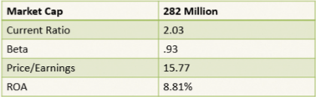
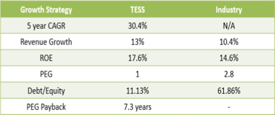
Tessco Technologies Inc. (TESS)
Tessco provides value chain solutions and products to support wireless systems. It operates in two segments: commercial and retail.
Investment rationale:
- Strong Financials
- YTD Return: 48.3% (Industry: 14.8%)
- % Long Term Debt to Capitalization has been decreasing
- S&P invisibility of 74%
- Earnings beat analyst expectations four quarters in a row
- Steady increase in EPS up through March 2013
- Strong Treynor ratio: 31.1% (Technology SPDR XLK:14.6%)
- Positive industry outlook:
- Capital IQ: telecom equipment purchases will pick up in the second half of 2013
- IT industry thriving
- Bought 600 shares at $35.9

Slide 52

Wyndham Worldwide Corp. (WYN)
Industry: Lodging
Bought at: $67.31
One of world’s largest providers & franchiser of travel-related products/services for businesses & consumers
Operates in 3 segments: lodging, vacation exchange & rentals, vacation ownership
1-yr target est: $73.42
Net income rose 18% in Q3
Rev. increase over 10% across all business lines
Value requirement | Industry | WYN
Price/sales | 2.01 | 1.78
Price/BV | 6.1 | 5.2
Div. yield | 1.2% | 1.6%
Positive FCF | Varies | Yes- $816 mil

Slide 53
Risk Analysis
Notes:
*

Slide 54
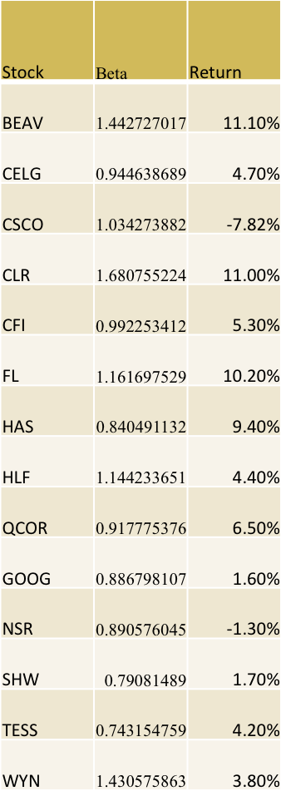
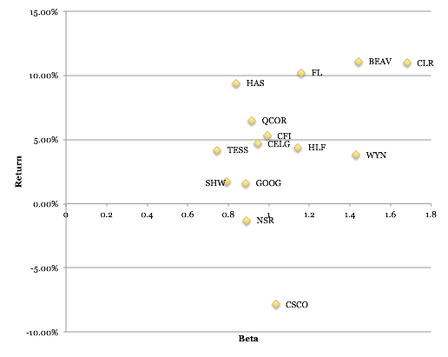
Beta vs. Return (Fall 2013)

Slide 55
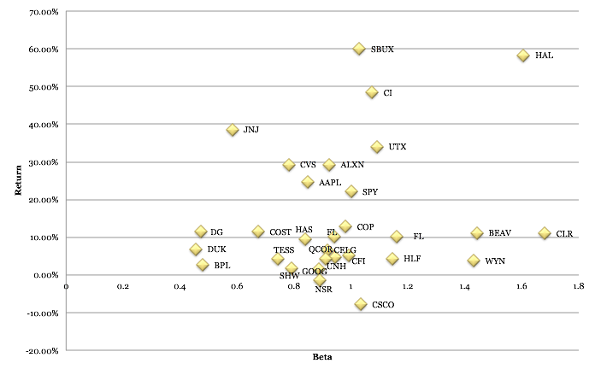
Beta vs. Return (All Stocks)

Slide 56
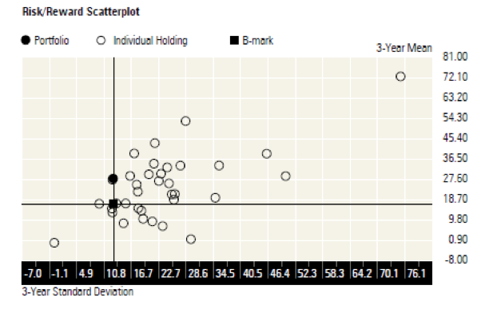
Risk/Reward Scatterplot
This was made on a Morningstar report and shows the portolio and individual stocks standard deviation against the reward
The benchmark is the Morningstar us market TR

Slide 57
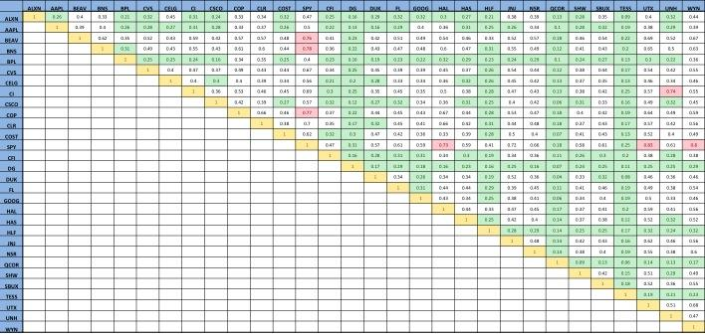
Correlation Matrix

Slide 58
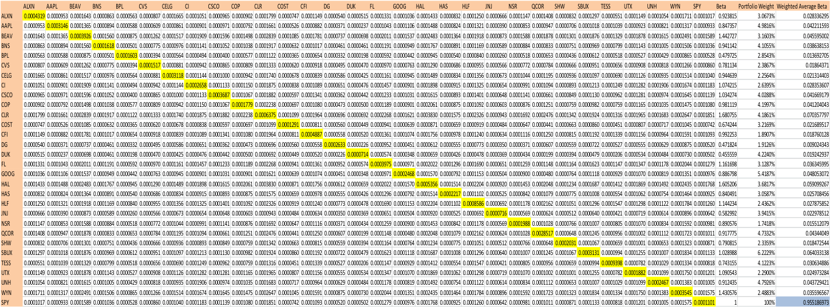
Covariance Matrix

Slide 59
SAP Performance Evaluation
Notes:
*

Slide 60
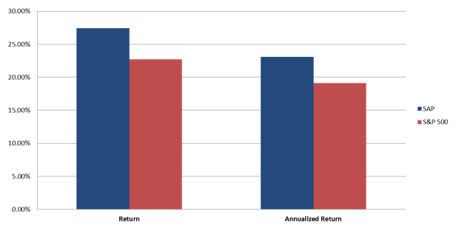
SAP Fund vs. Benchmark

Slide 61
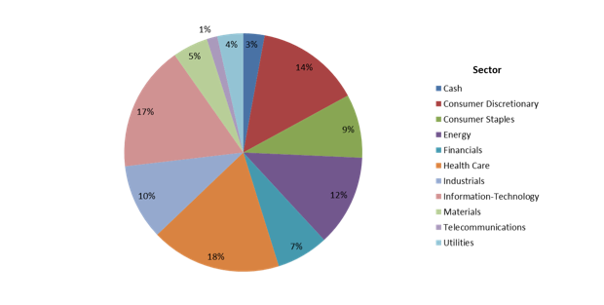
Sector Breakdown

Slide 62
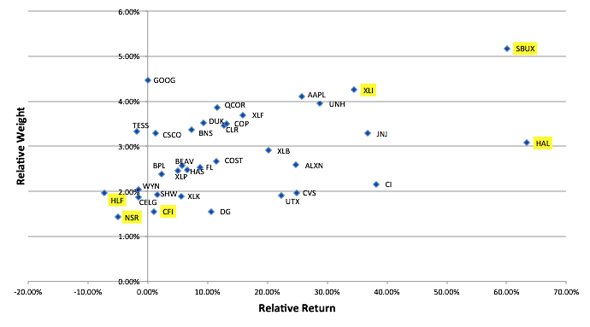
Weight vs. Return

Slide 63
Recommended Future Enhancements
Notes:
*

Slide 64
Recommendations
1. Revisit screens
-Make some adjustments
-Perhaps set screens to be sector-specific
- Class particularly encourages new students to revisit screens for technology & telecomm,
2. Assure students understand screening metrics and the meanings of individual metrics
3. Encourage a critical investment approval process to assure a challenging learning experience and realistic investment process

Slide 65
Student Manager Profiles
Notes:
*

Slide 66
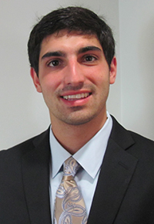
Jonathan Barr
Hometown: Colts Neck, NJ
Major: Finance
Minor: Information Systems
Campus activities: Member of the Club Hockey Team

Slide 67
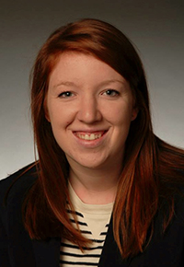
Margaret Brennan
Hometown: Hingham, MA
Major: Finance
Minor: Information Systems
Campus activities: Financial Management Association Member; Ignatian Society Student Tour Guide; Relay For Life Committee Member
Internship experience: Planning and Allocation Intern at Casual Male Retail Group
Additional information: Studied abroad in Cork, Ireland at University College Cork

Slide 68

Caroline Byrne
Hometown: Brooklyn, NY
Major: Finance
Minor: Information Systems
Campus activities: Relay For Life Mission Committee Co-Chair; Financial Management Association Member
Internship experience: Investment Intern for New York Community Trust; Claims Intern for AXA Art Insurance Corporation

Slide 69
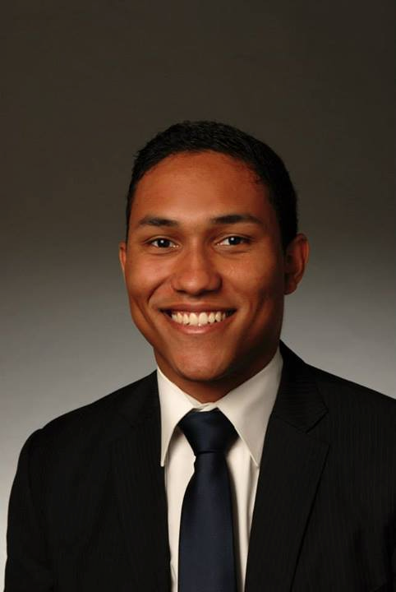
Joseph Deraville
Hometown: Maplewood, NJ
Major: Finance
Minor: Information Systems
Internship experience: Corporate Summer Analyst 2013 JPMorgan, NYC; Corporate Commercial Banking Summer Analyst 2012 Citigroup, Shanghai, CH
After Graduation: Joining JPMorgan's Corporate Analyst Division
Additional information: Studied abroad in Spain, Spring 2013

Slide 70
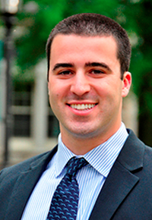
Tom Gasbarro
Hometown: Fairfield, NJ
Major: Finance
Minor: Spanish
Campus activities: CFO of Student Government Association; VP of Beta Gamma Sigma; Treasurer of Alpha Sigma Nu
Internship experience: Finance Summer Analyst at Morgan Stanley in Baltimore
After graduation: Would like pursue a career in business management or financial consulting
Additional information: Studied abroad in Alcala, Spain in Fall 2012

Slide 71
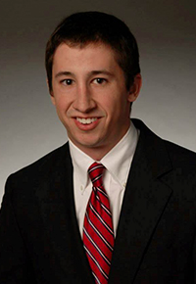
Peter Groglio
Hometown: Westport, CT
Major: Finance
Minor: Information Systems
Campus activities: President & Captain of Club Golf Team;
Member of Club Ultimate Frisbee Team; Worked 3 years at Loyola
Fitness and Aquatics Center; Was Member of Student Dining Committee
Internship experience: Business Development Intern at KAYAK;
Financial Services Intern for Terex Financial Services
After graduation: Looking to get a job as an Analyst for an Investment Banking Firm, hopefully in Capital Markets
Additional information: Studied abroad in New Zealand at University of Auckland

Slide 72
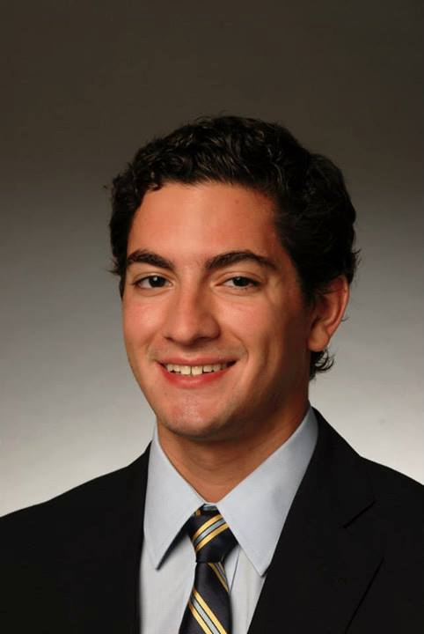
Shan Kadkoy
Hometown: Montague, NJ
Major: Finance
Minor: Information Systems
Campus activities: Loyola Men’s Swimming Team
Additional information: Studied Abroad in Alcalá de Henares, Spain Spring 2013

Slide 73
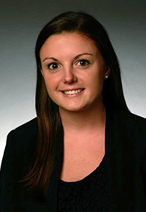
Meghan Kearney
Hometown: Needham, MA
Major: Finance; Management
Campus activities: Yearbook editor-in-chief; Sellinger Scholars;
York Rd. Student Association
Internship experience: Jr. Portfolio Analyst, Wasabi Ventures;
Advisory Risk Intern, Ernst & Young
After graduation: Has accepted an offer to work in Advisory Services
at Ernst & Young in Boston after graduation, specifically in the Risk practice

Slide 74
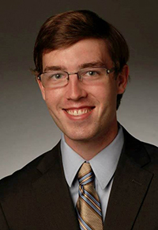
John Kelley
Hometown: Fairfax Station, VA
Major: Finance
Minor: Information Systems
Campus activities: Vice President of Finance of the Financial Management Association; Vice President of Policy and the Treasurer of the Residence Hall Association; President of the Loyola Ultimate Frisbee team; Participant in the 2013-2014 CFA Research Challenge analyzing U.S. Silica Holdings Inc.
Internship experience: Investment Strategy Intern AEGON USA Investment Management in Baltimore, MD; Financial Advising Intern at AXA Advisors in Washington, DC

Slide 75
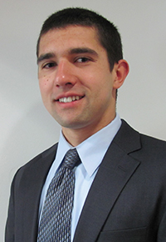
Benjamin Kimball
Hometown: Duxbury, MA
Major: Finance
Campus activities: Financial Management Association Member, Financial Management National Honor Society Member, Desk Assistant, Habitat for Humanity, Tutor at St. Ignatius of Loyola in Baltimore.
Internship experience: Worked at a YMCA overnight camp for the past few summers
Additional information: Studied Abroad in Newcastle, England for the Fall Semester 2013

Slide 76
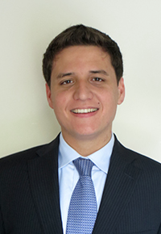
Robert Klener
Hometown: Short Hills, NJ
Major: Finance
Minor: Spanish
Internship experience: Operations Analyst Development Program Summer Internship at JP Morgan during Summer of 2013

Slide 77
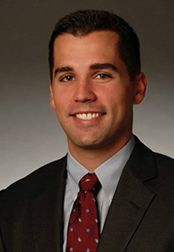
Kyle Mara
Hometown: Rockville Centre, NY
Major: Finance
Campus activities: Member of the FMA; President and Captain of the Club Lacrosse Team
Internship experience: Worked for WCBS Radio as a summer intern, where Kyle worked under the New York Yankee's Ad/Sales Broadcast Team
After graduation: Plans on attending law school

Slide 78

Patrick McKelvey
Hometown: Buffalo, NY
Major: Finance
Minor: Natural Science
Campus activities: Health Leads Advocate, Member of Students In Free Enterprise, Member of the Financial Management Association
After graduation: Plans on attending medical school and pursuing a career within the Healthcare sector

Slide 79
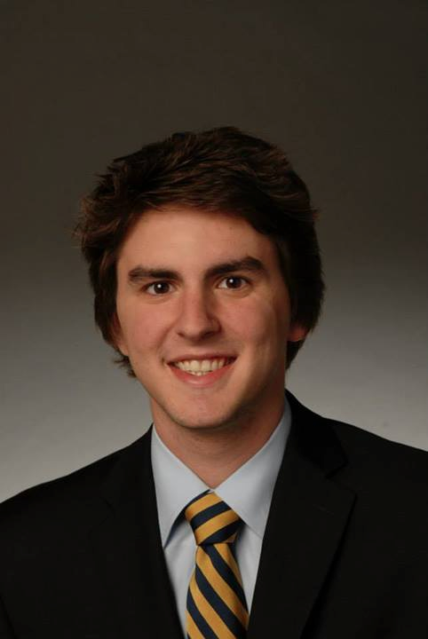
Brian McKinney
Hometown: Perry Hall, MD
Major: Finance
Minor: Information Systems
Campus activities: National Honor Society Financial Management Association Member
Internship experience: Financial Analyst Intern at WMS Partners, LLC in Towson, MD

Slide 80
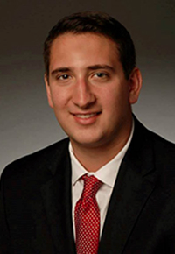
Rocco Natalicchio
Hometown: New Egypt, NJ
Major: Finance
Minor: Economics
Campus activities: President of Men's Club Basketball;
FMA VP of Communications; Sellinger Scholars
Internship experience: Investment Team Intern at JMI Equity;
Investment Banking Summer Analyst at Harris Williams & Co.
After graduation: Will be an Investment Banking Analyst at RBC Capital Markets in NYC

Slide 81
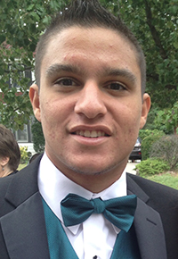
Frank Nicoletta
Hometown: Middletown, NJ
Major: Finance
Minor: Information Systems
Campus activities: Captain/Club president of Men’s Club Soccer

Slide 82
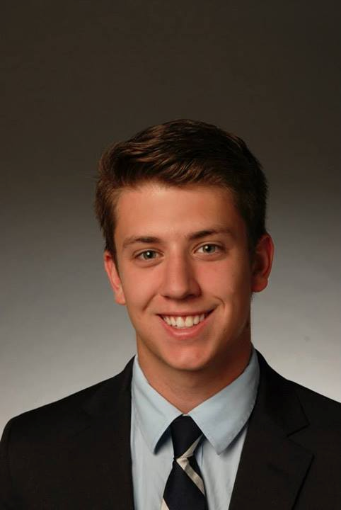
Jonathan Raffensperger
Hometown: Annapolis, MD
Major: Finance
Minor: Information Systems
Internship experience: Intern for the past two years with Capitalist Investment Services, a wealth management firm in Annapolis
After graduation: After graduation Jonathan plans on working and living in Baltimore
Additional information: Studied Abroad in Copenhagen, Denmark

Slide 83
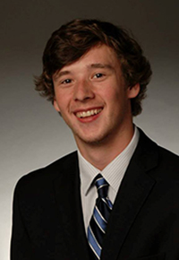
Wojtek Sarzynski
Hometown: Wilton, CT
Major: Finance; Marketing
Campus activities: Member of the Loyola Marketing Association; Member of the Financial Management Association; Previously a Residential Assistant and volunteer for Habitat for Humanity; Studied abroad in New Zealand
Internship experience: Intern at Factset as a data administrator
After graduation: Would like to pursue a job in the field of finance as an analyst

Slide 84

Alex Sfoggia
Hometown: Glen Cove, NY
Major: Finance
Minor: Information Systems
Campus activities: Financial Management Association;
CFA Investment Research Challenge
Internship experience: Financial Intern at Financial Concepts Unlimited, Inc., a wealth management firm based in Annapolis, Maryland
After graduation: Plans to find a job and hopefully start a career in investment banking

Slide 85
Bob Toner
Hometown: Cotuit, MA
Major: Finance
Campus activities: Sellinger Scholars Program; Financial Management Association; Production Manager at WLOY Radio Station
Internship experience: Interned at Traveler’s Insurance this past summer in the CAE Department
After graduation: Looking to pursue a career in consulting
Additional information: Studied abroad in Copenhagen

Slide 86

Marc Tufo
Hometown: Eastchester, NY
Major: Finance
Minor: Information Systems
Campus activities: Financial Management National Honor Society
Internship experience: Interned this past summer at Cantor Fitzgerald in New York on the sales & trading floor with the Short Term Interest Rate Sales & Trading Team; Currently interning for the CannonToohey Group with UBS Wealth Management in downtown Baltimore as a Wealth Management Intern
After graduation: Plans to return to New York to work his way up to being a part of a Sales & Trading Team

Slide 87

Dr. Frank D’Souza
Academic Degrees: Ph D, Oklahoma State University; MBA, St. Cloud State University, Minnesota; Bachelor of Commerce, University of Bombay.
Professional Memberships: Finance Management Association, American Finance Association, Eastern Finance Association, Southwestern Finance Association, Beta Gamma Sigma.
Representative Publications:
D'Souza, F., Ellis, N., & Fairchild, L., (2010), "Illuminating the Need for Regulation in Dark Markets: Proposed Regulation of the OTC Derivatives Market", University of Pennsylvania Journal of Business Law, 12, 473-516
Carter, D., D'Souza, F., Simkins, B., & Simpson, W.G., (2010), "The Gender and Ethnic Diversity of US Boards and Board Committees and Firm Financial Performance", Corporate Governance: An International Review, 18(5), 396-414
Simpson, W. G., Carter, D., & D'Souza, F., (2010), "What Do We Know About Women on Boards", Journal of Applied Finance, 20(2), 27-39
D'Souza, F., Fletcher, H., & Ionici, O., (2011), "Equity Market Timing and Subsequent Delisting Likelihood", International Journal of Business and Finance Research, 5(2) 85-94
"Chapter 18: Cost of Capital: An Introduction", Ionici, O. & Small, K. & D'Souza, F., in "Capital Budgeting Valuation: Financial Analysis for Today's Investment Projects". Edited by H. Kent Baker and P. English (2011).

Slide 88
Thank you!
On behalf of the entire Sellinger Applied Portfolio class, we would like to express our sincere gratitude for the opportunity to participate in this truly unique and rewarding experience.
Special thanks to Legg Mason, Dean Leggio, Dr. D’Souza, the Department of Finance, and the Board of Trustees Investment Committee for making this experience possible.

